Slide 1
Attitudes towards Marine Reserves in the deep sea
16 May 2016

Slide 2
Method
Only demographic differences that are significant at the 95% confidence interval are shown.
Respondents were New Zealanders aged 18 and over.
In total 1,150 New Zealanders took part in this research.
Respondents were sourced from Colmar Brunton’s online panel. We boosted the number of respondents who identify as Māori with additional interviews in order to analyse this group separately.
The data was post-weighted so the final sample is representative of New Zealanders 18+ by age, gender, region, and whether they identify as Māori or non-Māori.
Percentages may not add to 100% or nett scores due to rounding.
%
n=1,150
Fieldwork –
27 April – 8 May 2016.
Questions were placed on Colmar Brunton’s online omnibus.

Slide 3
Findings

Slide 4
Three quarters of New Zealanders think NZ’s deep oceans should also be included in the marine reserve legislation.
NETT SUPPORT
NETT OPPOSE
76%
12%
69%
18%
Q
Q2. Do you support or oppose New Zealand’s deep oceans also being included in the legislation for marine reserves? Note: Full question wording is in the appendix.
Base: All respondents (base sizes shown on chart). Percentages may not add to 100% or nett scores due to rounding.

Slide 5
Demographic differences.
NETT SUPPORT
NETT OPPOSE
76%
12%
Those more likely to definitely support include:
Wellington residents (49%)
Those who identify as NZ European (43%)
Those in higher income households, $150,000+ (51%)
Those more likely to probably support include:
Younger NZers, 18 – 29 yrs (45%)
Those who identify as Asian (56%)
Those more likely to probably oppose include:
Older NZers, 60+ (16%)
Those who are retired (17%)
Those more likely to definitely oppose include those in higher income households, $150,000+ (7%)
Those more likely to support include those who identify as NZ European (78%)
Those more likely to oppose include:
Older NZers, 60+ (20%)
Those who are retired (18%)
Those who identify as Māori (18%)
Those less likely to support include those who identify as Māori (69%)
Those less likely to definitely support include those who identify as Asian (17%)
Those less likely to probably support include those in higher income households, $150000+ (26%)
Those less likely to probably oppose include younger NZers, 18 – 29 yrs (4%)
Those less likely to oppose include:
Younger NZers, 18 – 29 yrs (6%)
Those who identify as NZ European (11%)
Q
Q2. Do you support or oppose New Zealand’s deep oceans also being included in the legislation for marine reserves? Note: Full question wording is in the appendix.
Base: All respondents (base sizes shown on chart). Percentages may not add to 100% or nett scores due to rounding.

Slide 6
Questions

Slide 7
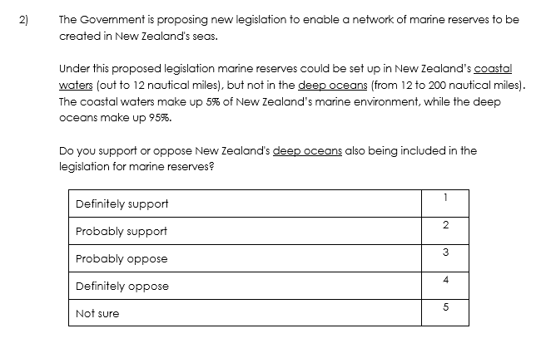
Question

Slide 8
FOR FURTHER INFORMATION PLEASE CONTACT:
Ellen Parkhouse
Michael Dunne
Colmar Brunton, a Millward Brown Company
Level 9, Legal House, 101 Lambton Quay, Wellington
PO Box 3622, Wellington 6140
Phone (04) 913 3000
www.colmarbrunton.co.nz

