Slide 1
JUNE 2016
TEMPERATURES
RAINFALL
RIVER FLOW
GROUNDWATER & SOIL
AIR QUALITY
MINISTRY OF PRIMARY INDUSTRIES

Slide 2
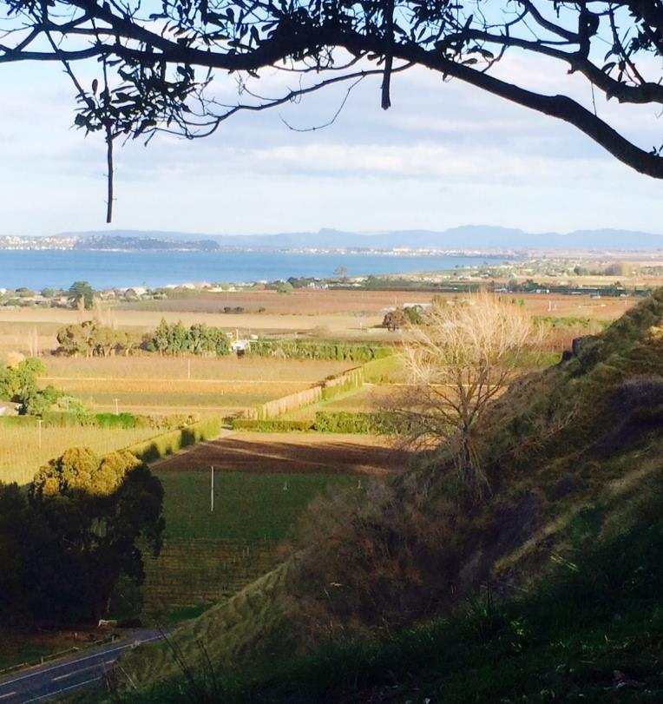
JUNE 2016
We’ve been stuck in - or embracing, depending on your perspective - a pattern of warmer and drier weather than usual, but the cracks are starting to appear… maybe.
June rainfall was below normal for the fifth month running but at least northern parts of the region fell in or above the normal range, and the half-decent dump of rain at the end of the month helped matters elsewhere.
River levels finished the month still well down on normal levels and likewise our groundwater stocks.
Soil moisture in the north looks fairly spot on for June while in the south more rain wouldn’t go amiss.
And yes, it was warm again for the sixth month on the trot but by crikey we had some sharp and frequent frosts. Which helps to explain the elephant in the room – our AIR QUALITY. To be blunt, this was quite dismal. The health standard for PM¹⁰ was exceeded four times in Hastings - compared to just one for all of last winter. Listen to my heavy, fog-blanketed sigh …
Kathleen Kozyniak
Senior Scientist Climate & Air

Slide 3
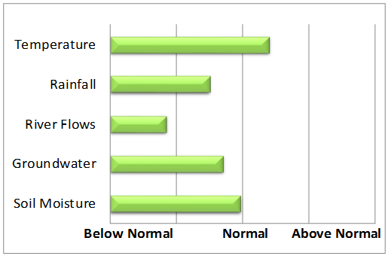
SUMMARY – June 2016
The short summary – ditto from May … still dry and warm
This is a summary of the regions rainfall, river flows, ground water, air quality and soil moisture levels. Data and images provided by HBRC.
July to September Forecast
Temperature Above average
Rain Normal or above normal
River flows Near normal or below normal
Soil moisture Near normal
(source : NIWA)
For more information
www.hbrc.govt.nz
P: 06 835 9200

Slide 4
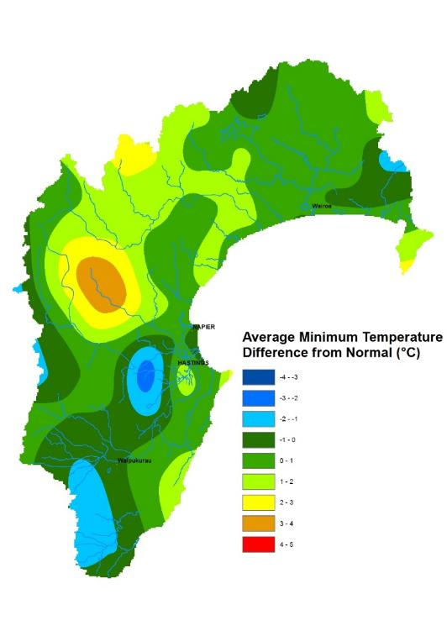
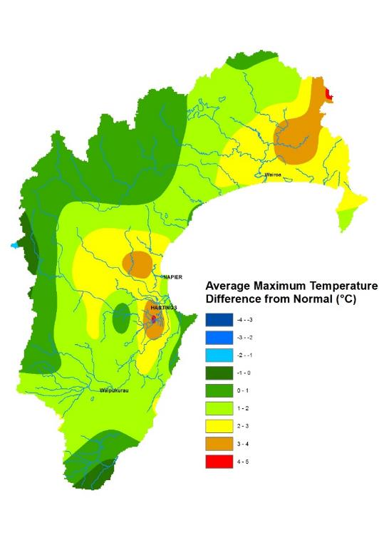
TEMPERATURES
Above average despite some sharp frosts.
Mean Difference from Normal
Mean Difference from Normal
Maximum Temperature: 1.8°C
Minimum Temperature: 0.6°C
Mean Daily Maximum: 14°C
Mean Daily Minimum: 5°C
Highest Daily: 25.1°C
Location: Napier Aero AWS
Lowest Daily: -5.7°C
Location: Taharua

Slide 5
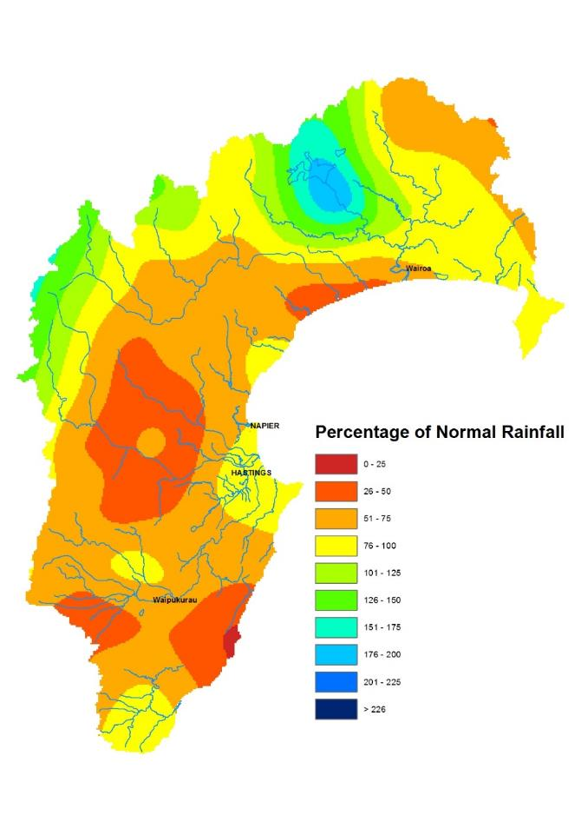
RAINFALL
Below normal, for the fifth month running
Percentage of normal June rainfall
(30 year average)
For areas in the region:
Waikaremoana 129%
Northern HB 88%
Tangoio 60%
Kaweka 74%
Ruahine 65%
Heretaunga Plains 64%
Ruataniwha Plains 59%
Southern HB 69%
Hawke’s Bay Region 76%

Slide 6
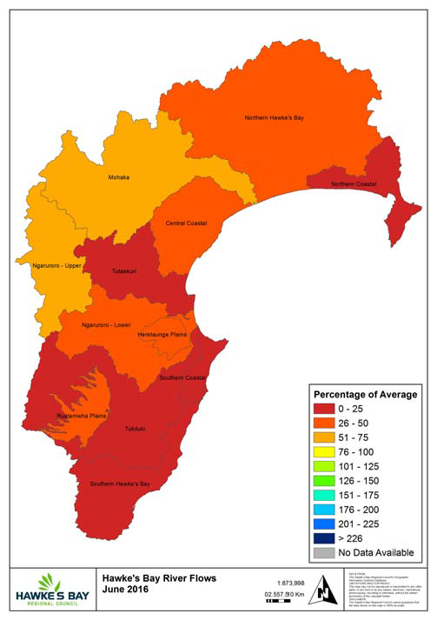
RIVER FLOW
Percentage of average June flows for areas in the region:
Northern Coastal 24%
Northern HB – Hangaroa River 46% Northern HB – Wairoa River 53%
Northern HB – Waiau River 104% Mohaka 68%
Central Coastal 37%
Tūtaekuri 22%
Heretaunga Plains 30%
Ngaruroro - Upper 72%
Ngaruroro - Lower 43%
Southern Coastal 23%
Ruataniwha Plains 32%
Tukituki 25%
Southern HB 3%
Hawke’s Bay Region 41%

Slide 7
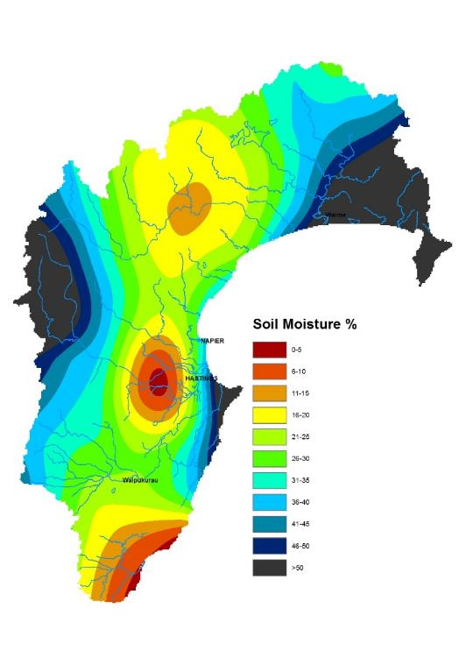
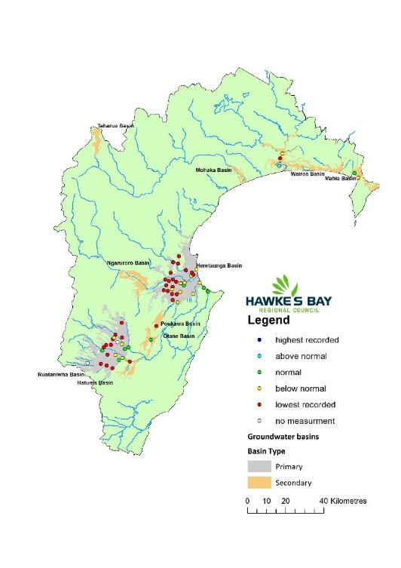
GROUNDWATER
& SOIL
Groundwater Levels
Heretaunga Basin Mostly lowest ever and below normal water levels
Ruataniwha Basin
Mostly lowest ever and below normal water levels
Secondary Basins A mix of water level conditions from above normal to lowest ever
Soil Moisture
Near normal in the north and below normal in the south

Slide 8
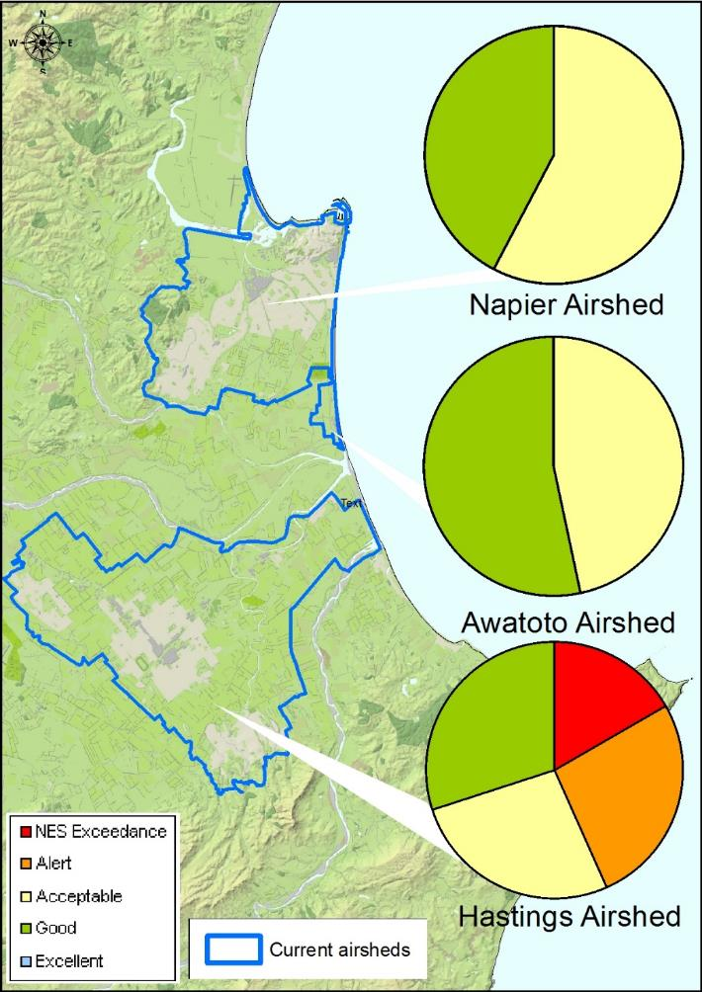
AIR QUALITY
June 2016
PM₁₀ exceedances: Terribly disappointing ☹
The National Environmental Standard (NES) for particulate matter (PM₁₀) of 50 micrograms per cubic metre (24 hour average) was not exceeded in the Napier and Awatoto airsheds in June 2016, but there were 4 exceedences in Hastings.
The monitoring sites are at:
- Marewa Park in the Napier airshed
- St Johns College in the Hastings airshed
- Waitangi Road in the Awatoto airshed.

Slide 9
MINISTRY FOR PRIMARY INDUSTRIES
June 2016
Rain in the last week of June was a huge relief to farmers and growers around the region. It will help build pasture covers moving into spring. However, in dry areas to the south and east of Hastings, the winter feed situation remains very tight due to low soil moisture and frequent frosts. Low pasture covers are especially difficult for early lambing farms in these areas. Farmers generally have fewer animals than usual because of the dry conditions and have kept stock in good condition with supplementary feed. Farms north of Napier are also drier than normal but generally faring much better.
The dry conditions underfoot in May and June allowed good progress to be made on orchards and vineyards with maintenance work and site preparation for new and replacement plantings. Pruning is well underway in vineyards. Pruning of pipfruit orchards has been slowed down by the delay in full leaf fall.
Winter chill is tracking well behind recent years. NIWA’s seasonal outlook for Hawke’s Bay is that winter will be warmer than normal. This means that flower numbers in spring could be lower for some fruit types, and the flowering period could be more spread out.
Annette Carey and Gillian Mangin
Ministry for Primary Industries

